Slide 1
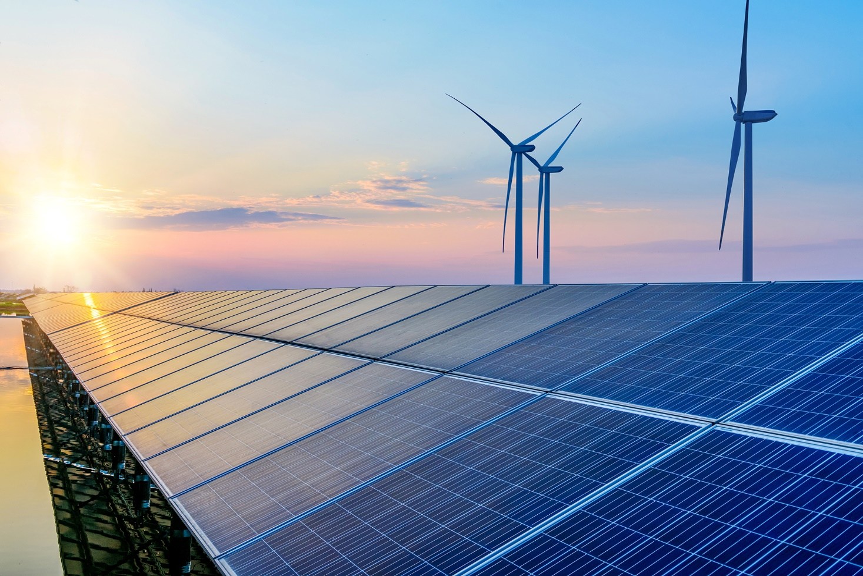




Strategic ideas for Malawi to attract finance for clean cooking
Vision for Malawi's transformational change to clean cooking, COP26 outcomes incl. new strategic opportunities to attract climate and carbon finance based on aligned SDG-NDC goals, gender and digital MRV/transparency transformation
Karen Holm Olsen & James Haselip,
Senior Researchers
kaol@dtu.dk & james.haselip@un.org
UNEP DTU Partnership/
UNEP Copenhagen Climate Centre

Slide 2
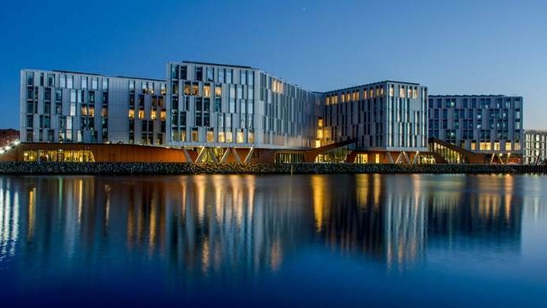
Who we are
- Collaborating Centre supporting UNEP for more than 30 years, activities fully aligned with UNEP's Program of Work
- 70 Staff from more than 26 different nations
- Until 2022 part of DTU Management at the Technical University of Denmark with access to a broad range of scientists and specialists
- A wide network of collaborating institutions and partners in more than 70 developing countries
- Until 2022 a non profit public institution with highest standards on procedures, transparency and accounting
UNEP DTU Partnership, renamed UNEP Copenhagen Climate Centre (UNEP CCC) effective from 1 March 2022

Slide 3
Malawi's Energy Compact and vision for transformational change to clean cooking
Vision: Phase out of current open fireplaces using unsustainably produced charcoal/firewood with negative health impacts and transition to renewable energy (RE) production and GHG emission reductions (at least 40%)
On the pathway to net-zero emissions by 2050 the entire biomass fuels should come from sustainably managed RE (solar PV, wind, geothermal etc.) and/or modern energy cooking services (e.g. LPG, electric and solar cooking).
Positive SDG impacts are related to increased forest restoration and reduced land degradation (SDG 15), reduced health impacts (SDG 3), gender-transformative approach to equality (SDG 5), income generation and poverty reduction (SDG 1).
Attracting innovative carbon and climate finance can help accelerate the transition to clean cooking
Source: Malawi SDG7 Cleaner Cooking Energy Compact, 22 Sep. 2021

Slide 4
Strategic opportunities for Malawi to attract finance for clean cooking under the Paris Agreement
Source: 'The COP26 Climate Change Conference. Status of climate negotiations and issues at stake', European Parliament, Oct. 2021

Slide 5
Main outcomes of the Glasgow Climate Pact
A shift in vision and rhetoric:
  Universal and strong recognition of the role of science incl. data/evidence based policy making
  Considerable increase in number of net-zero emissions pledges
Shift gears on ambition and action:
  Aligning NDCs with net-zero
  Revisit and strengthen 2030 targets next year in 2022
  Annual ministerial round table on pre-2030 ambition
  Coal and fossil fuel subsidies in the decision text for the first time
  Urges submissions of NDCs and long-term strategies from countries who have not yet done so
A number of interesting announcements (cleaner cooking pledge, global coal to clean power transition, halt and reverse deforestation pledge, zero-emissions cars, methane pledge)

Slide 6
New finance options incl. for adaptation, loss and damage
A note of “deep regret” that the $100bn climate finance goal has not yet been met, developed countries “urge[d]” to “fully deliver…urgently and through 2025”
A pledge from developed countries to “at least double” adaptation finance between 2019 and 2025
Adaptation Fund raised record US$ 356 million in new pledges at COP26 for its concrete actions to most vulnerable - 16 Donors, grants
Acknowledgement of the loss and damage already being caused by warming and welcome for the operationalisation of the “Santiago Network”
A two-year Glasgow Dialogue “to discuss the arrangements for the funding of activities to avert, minimize and address loss and damage (no specific action yet)

Slide 7
COP26 outcomes for transparency/MRV
Agreement on:
Modalities, procedures and guidelines (MPGs) for the enhanced transparency framework for action and support referred to in Article 13 of the Paris Agreement
Information necessary for countries to track progress made in implementing and achieving its NDC in a narrative and common tabular format (CRTs, very technical)
Common time frames (NDC communicated in 2025, de facto 5-year time frames), operationalisaton of flexibility in reporting, legal status of CRTs (mandatory), information on adaptation, reference to use of 2019 refinement of IPCC 2006 guidelines (voluntary)
Also agreement on the outlines for the:
Biennial transparency report, BTR (formerly BR and BUR)
National inventory document, NID (formerly NIR) and
Technical expert review report, TERR (formerly TRR)
Strategic opportunity: Impact assessment of policies and actions for NDC implementation incl. digital MRV at project/programme level can be regarded as 'the new oil' in terms of the ability by countries and stakeholders to attract results-based finance (RBM), both public and private investments.

Slide 8
Carbon finance for clean cooking: What is Article 6?
Unpacking the Article 6 'rulebook' agreed in Glasgow for implementing the PA:
A6.1 preamble: unitary objectives, voluntary cooperation, allow for higher ambition of NDCs, promote SD and EI
 | Art. 6.2 Cooperative approaches | Art. 6.4 Mechanism | Art. 6.8 Framework and work program
Rulebook | Guidance for cooperative approaches | Rules, modalities and procedures (RMPs) for the mechanism | A work programme under the framework for non-market approaches
Governance | Bottom-up, nationally determined | Top-down, centrally managed by Supervisory Body, 'CDM-like' | Glasgow Committee on Non-market Approaches
ITMOs | Yes | Yes | No
Strategic opportunity: To attract carbon finance Malawi needs capacity to authorize ITMO's through a corresponding adjustment in relation to its NDC. Under CDM, Designated National Authorities (DNAs) had the role to approve projects/programs contribution to SD priorities of the country. Today, DNAs need capacity to also authorize ITMOs, aligned with national transparency reporting of NDC implementation and GHG inventories.

Slide 9
COP26 outcomes for Article 6 - new infrastrcuture
The rulebook enables rapid implementation of carbon markets to achieve NDCs and increase ambition, beyond current targets
Capacity building support agreed for developing countries, particularly to enable host Party authorizations of ITMOs based on national accounting and reporting data integrated with transparency for tracking progress of NDC implementation

Slide 10
Conclusion
Three strategic ideas to attract finance for the clean cooking transformation in Malawi:
Align NDC and SDG goals and impact assessment for net-zero and sustainable development at national level with the global goals in the Paris Agreement and 2030 Agenda
Attract climate finance to build institutional capacity for MRV/transparency to collect and analyse data for impact assessment of NDC implementation
Attract carbon finance for clean cooking policies and programmes at scale, designed to meet NDC national goals

Slide 11

Thanks!
Karen Holm Olsen & James Haselip, Senior Researchers
UNEP DTU Partnership/UNEP Copenhagen Climate Center
Contacts: kaol@dtu.dk & james.haselip@un.org

